Slide 1
The Windows House of mirrors: A roller coaster tour of the subsystems you use every day.
Stephen Owen
@FoxDeploy
FoxDeploy.com
Automation Engineer
Big Bank
Shaun Cassells
@Cassells
www.shauncassells.com
MVP, Principal Solution Engineer
Jeff Scripter
JPScripter@gmail.com
Application System Engineer
Big Bank

Slide 2
Jeff Scripter
Stephen Owen
Shaun Cassells
Edit Master text styles
@JeffTheScripter
@cassells
Edit Master text styles
Kids in college before age 5
Edit Master text styles
Forgotten so much
15 Years
Beer, Coffee and Chocolate
Edit Master text styles
Alfresco and local

Slide 3
Outline
Registry
COM/DCOM
WMI
Component based servicing - SXS
Telemetry
DPAPI

Slide 4
The Registry

Slide 5
Where did this all begin
In windows 3.1, to organize the COM configuration info.
In win 95 and NT, Replaced the perfusion of ini files.
For better performance, the registry was read into memory on boot.
Allows for permissions to be granularly delegated and give users access.
Using standard Types (strings, dword, qword, etc)
Hive - Files where the registry data is stored.
Key - sub paths to different settings
Values - the Values
Notes:
by creating a single central location for settings. This started happening in windows 3.1 to organize the COM configuration info.

Slide 6
How the Registry works
HKLM - Used to store system level settings and configurations.
SOFTWARE - Application settings
%Systemroot%\system32\config\Software
SAM - Security Account manager
%Systemroot%\system32\config\SAM
SYSTEM - Protocol, services, Drivers
%Systemroot%\system32\config\System
ControlSet Current - generated for this current boot
Set1 - Backups for recovery
HARDWARE - Generated on the fly
SECURITY - policies and stored secrets
%Systemroot%\system32\config\Security

Slide 7
How the Registry works
HKCU - User profile, application and environment settings
%userprofile%\NTUser.dat - Kind of
This is a session based alias for HKU.
HKU - All user profiles loaded
<SID> - The permanent mounting HKCU for all users
%userprofile%\NTUser.dat
<SID>_classes - HKCR Permanent mounting location
DLL, File Extensions, Defaults
%userprofile%\AppData\Local\Microsoft\Windows\usrclass.dat

Slide 8
How the Registry works
HKCR - Melding of the user and system settings
COM object and other DLL registration (CLSID)
APPX Registration
File extension defaults
Shell defaults
File icon paths.
User settings - HKEY_USERS\<SID>_Classes
System settings - HKEY_LOCAL_MACHINE\SOFTWARE\Classes
If there is the same key but different value, the user key wins.
HKCC
Loaded on startup
Alias for HKLM\System\CurrentControlSet\HardwareProfiles\Current

Slide 9
Com/Dcom

Slide 10
Component Object Model
This was a way to more easily allow software to interact with each other.
Mostly for local software interactions, DCOM was added to allow for remote software interactions.
Just a COM object with remote access build added.
COM+ is just the COM but with more bells and whistles (V2)
Two types:
In process – Uses the DLL directly.
Out of process – launches and EXE.
Notes:
The com interface was introduced in 1993 as an application binary interface. This was later updated to allow cross machine interfaces with DCOM. Currently, this is mostly been replaced\wrapped with the CLR standards in .net and DCOM has transitioned more to web services like soap and rest. However, There are still several applications that rely on COM.

Slide 11
How it works
Com objects are binary interfaces that are registered in HKR (User or machine)
DLLs register as a com name and version
Com object Interface name
Hkey_Classes_root\<Interface>\CLSID
CLSID is located
Hkey_Classes_Root\CLSID\<CLSID>
This will locate the binary that can manage the interface.
Notes:
new-psdrive -Name hkr -PSProvider Registry -Root hkey_classes_root -Scope script
$ComObject = Get-ChildItem -path hkr:\clsid\*\VersionIndependentProgID
Foreach ($ComObjectInterface in $ComObject)
{
$ComObjectInterfaceName - $ComObjectInterface.GetValue($Null)
New-object -ComObject $ComObjectInterfaceName
}

Slide 12
Practical
There are several applications that can have useful com interfaces like
MSI installer
windows updates
Office
RSA soft token
If you have to troubleshoot errors, The application event log can capture some of the more severe errors.

Slide 13
DCOM
Distributed Component Object Model was used as an old way to service remote client.
This is mostly replaced with web services
Registered as apps in
HKEY_CLASSES_ROOT\AppID
DCOM can be controlled in the comexp.msc snapin

Slide 14
WMI
🎺 The skeleton key to basically everything 🎺

Slide 15
What is wmi?
Windows Management Instrumentation
Microsoft’s take on the standard
What standard?
Web Based Enterprise Management Consortium and DMTF
Is it CIM?
Notes:
You know what they say about standards…
Desktop Management Task Force MS was a member included tons of industry leaders, needed to solve the need of how to manage desktops en masses
Amusingly there is still a tool in windows which references this ancient heritage,
Windows Server 2012 and Windows 8 saw Microsoft make some changes to WMI by aligning it with CIMv2 and moving to WS-MAN for remote connections. Because WS-MAN is a HTTP-based protocol, it is more firewall friendly than DCOM. Although it’s worth noting that the updated WMI stack can be accessed using DCOM for backwards compatibility.
PowerShell Core doesn’t even have them the WMI cmdlets

Slide 16
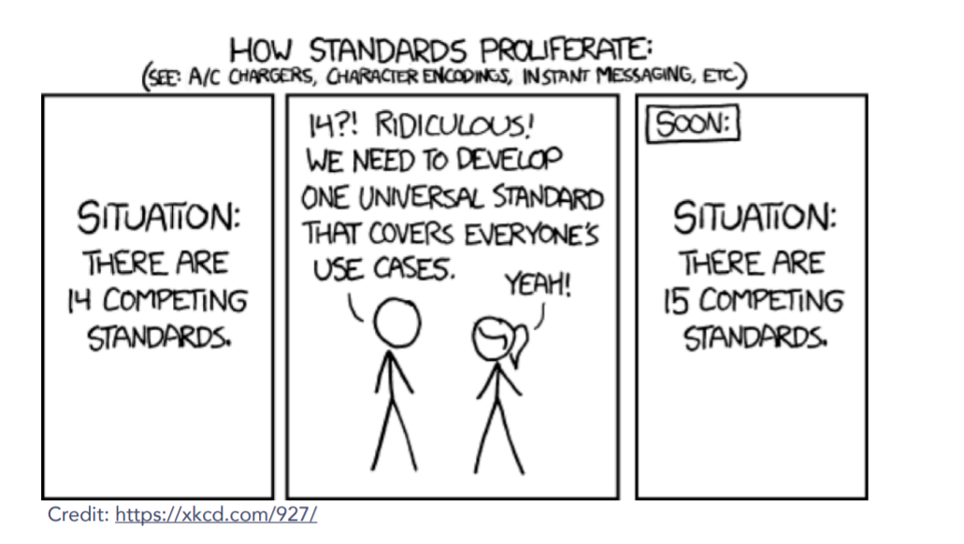
The great thing about standards is…
There are so many to choose from!

Slide 17
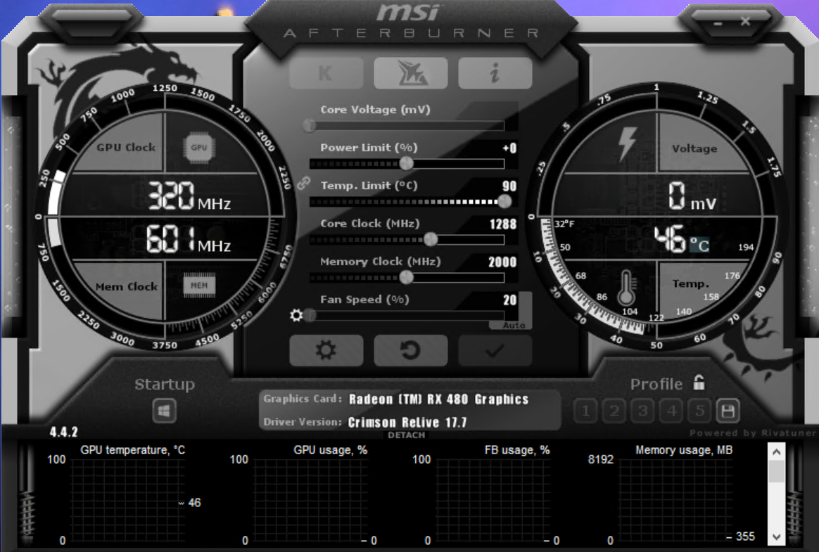

Why bother with wmi?
It’s everywhere…
…..in Windows
If it’s not in the registry…guess where it lives in Windows?
Database vs API
Solves this common life scenario…
Time to update drivers…
Or flex on noobs
Notes:
This is deep in windows, it’s been part of the OS since Windows 95, and kind of cutely, you can still find hundreds of articles walking you through installing it from way back when it was an optional feature on Windows NT 4.0 lol
Imagine you’ve been a totally boss at work and have built your own comepletly pimped out and not ostentatious gaming laptop.
To play Minecraft on.
Now because the pc embarrasses your wife, you have to hide it out of the way, and its time to update your bios and drivers…but your forget what mobo version you have.
You COULD>..crawl under the desk and look at it ☹ lame
Or you could open the eyeball frying terrible ‘GAMING’ app to find the settings…or you could dig into wmi for it (lets act like device manager doesn’t exist, too much clicking!)

Slide 18
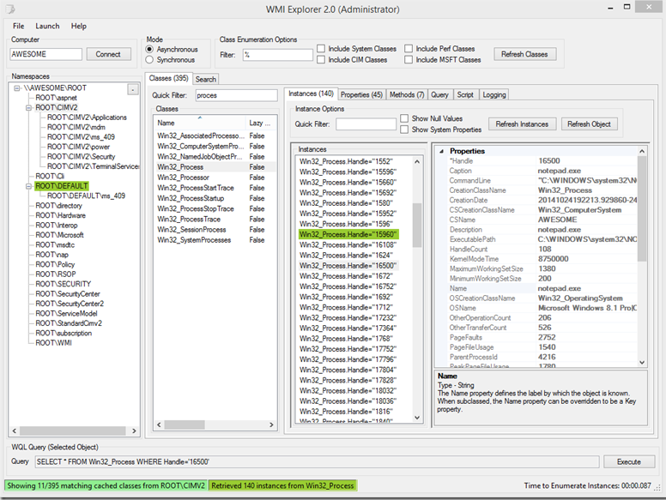
Tools to use with wmi
WMIC – keeping it old school
PowerShell
Search for classes w/ Get-CimClass!
WBEMTest
WMI Explorer
Notes:
We can use WMIC
Wmic service list | more
>wmic os LIST BRIEF
List information on currently running processes with WMIC –
wmic process get caption,executablepath,commandline
List user accounts with WMIC - wmic useraccount get /ALL
PowerShell. Great because has search function built in!
WBEMtest ‘Open istance’ WIn32_BaseBoard’
WBEMtest – Query “select * from win32_baseboard’
List patches installed on the local workstation with WMIC –
wmic qfe get description,installedOn /format:csv
Humble beginnings. In The Monad manifesto revisted talk, Snover told a story of the development of powershell and wmic. Shortlink at the end!
List information on currently running processes with WMIC –
wmic process get caption,executablepath,commandline
List user accounts with WMIC - wmic useraccount get /ALL
WBEMtest ‘Open istance’ WIn32_BaseBoard’
WBEMtest – Query “select * from win32_baseboard’

Slide 19
WMI Organization
Hierarchy -> items are hierarchically organized
5 bonus points if you can pronounce this word.
Organized into Namespaces
Notes:
What an exciting slide title
Namespaces are basically folders where interesting wmi stuff lives

Slide 20
What lives where
Root\cimv2
Default namespace
Most basic windows settings
Win32_ComputerSystem – Basic OS Info
Win32_LogicalDisk – Drive by letter
Win32_DiskDrive – physical disk info
Win32_BaseBoard
Win32_VideoController
Notes:
What an exciting slide title
Namespaces are basically folders where interesting wmi stuff lives

Slide 21
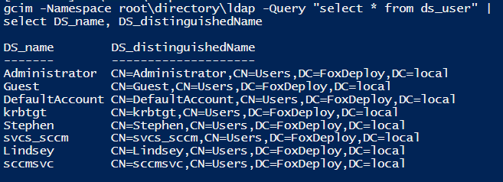
What lives where, electric boogaloo
Root\Directory\ldap
Perform Native AD Queries!
Root\ccm
SMS_Client – Reinstall CM Client, request policy, evaluatepolicy
TriggerAppInstalls
CImv2\Security
Encrypt/Decrypt Volumes
Notes:
What an exciting slide title
Namespaces are basically folders where interesting wmi stuff lives

Slide 22
Windows management instrument
Makes a modern Object based APIs for the windows OS. This is one of the reasons windows is an API based OS vs Linux being file based.
Built on the Common information Model (CIM), and wbem standards used by other OS but Microsoft added it's own spin on it with wmi. This groups information in related Object classes and leverages providers to manage those objects.
CIM - Data model and Data layout
WBEM - standards for interacting with CIM
WMI - Microsoft implementation of both
Started in Win NT SP4 as an web-based enterprise management (WBEM) tool.

Slide 23
Windows management instrument
Namespace
Permissions are managed in CompMGMT.msc
MOF - Managed Object Format
These are your classes definitions and link the provider
MFL
Message format language - XML used for interpreting binary data structure
Classes
This is the implementation of the MOF file and
Instances

Slide 24
Windows management instrument
Provider
These are registered under the clsid
__WIn32Provider – added by MOF
Registry
HKEY_LOCAL_MACHINE\SOFTWARE\Microsoft\Wbem
Database – Non-lazy objects are stored in the WMI database. Other are dynamically generated based.
C:\windows\System32\wbem
MOF Files – Located all over the system

Slide 25
Gotchas
Recompiling MOFs
It is hard to find all MOFS
Uninstall MOFs
WMIDIAG
Rebuilding Database
Obviously deletes stored data (Not Lazy objects)

Slide 26
Component Based Servicing

Slide 27
What is the Windows component based servicing
The subsystem that manages the files for windows.
Windows patches
MSIs
Attempts to resolve
Missing DLLs
DLL Versions
Duplicate DLLs
Where
C:\Windows\winsxs
HKEY_LOCAL_MACHINE\SOFTWARE\Microsoft\Windows\CurrentVersion\Component Based Servicing
SXSFile1.0
SXSFile2.0
File
SXSFile3.0
SXSFile4.0

Slide 28
Why does it take up so much space?
This allows for easy rollback of patches and software.
You can clean up the old files, but it prevents uninstalls
Cleanup wizard
Schedule task
\Microsoft\Windows\Servicing – StartComponentCleanup
DISM
Dism.exe /online /Cleanup-Image /StartComponentcleanup /ResetBase
Dism.exe /online /Cleanup-Image /SPSuperseded
DO NOT DELETE THESE MANUALLY!

Slide 29
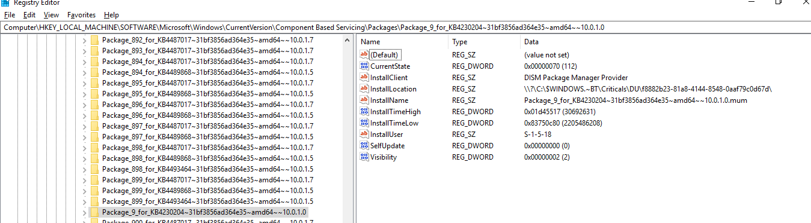
Tracing

Slide 30
How do I Troubleshoot it?
This allows for easy rollback of patches and software.
You can clean up the old files, but it prevents uninstalls
Sxstrace – Exports logging for sxs
CheckSur – Win 7 - Integrate checks for sxs
Dism – Win 10 - Integrate checks for sxs
DO NOT DELETE THESE MANUALLY!

Slide 31
Windows Telemetry

Slide 32

Telemetry – Huh What is it good for?
Absolutely EVERYTHING!
To the Cloud
Telemetry
I want to touch it!

Slide 33
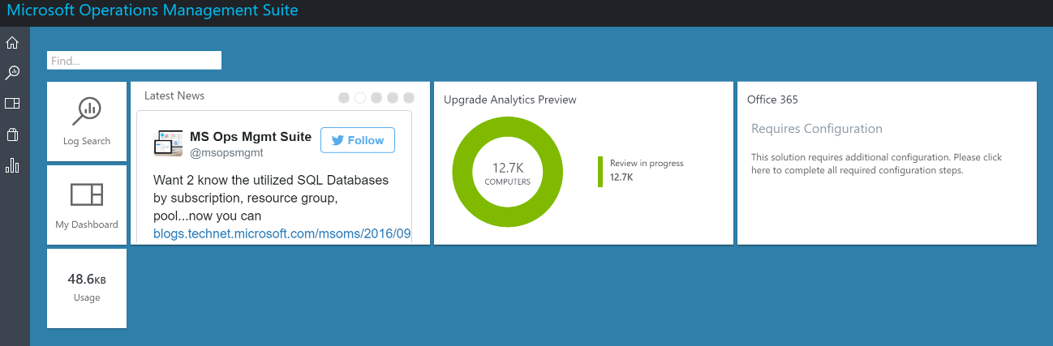
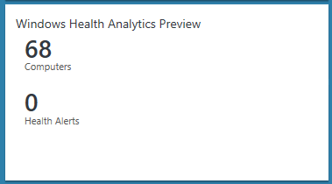


MSFT, as “IT admin” for consumers, uses diagnostic data to ensure OS, app and driver releases land with the right level of quality/health/compat
Windows Analytics gives IT diagnostic-based insights to their devices, exposed via Azure log analytics
IT controls the level of diagnostic data collected, which impacts Analytics availability
Windows Analytics Data Flow
MSFT Cloud
Azure Log Analytics
Diagnostic
Service
Telemetry Upload
GP/SCCM/Intune
Configure
Control
Value to customer: Reduce TCO via proactive insights
Value to MSFT: Diagnostic data helps us improve the product, staying current helps our ecosystem
Notes:
For last animation; customers often ask, after seeing all the great value we’ll talk about in this deck, “why don’t we charge extra for this great functionality?”, and the answer is that we want to help customers get and stay current because that is good for our ecosystem and we want enterprises to continue to share at least basic telemetry with us because it helps make Windows better; so we feel this is sufficient value for us.

Slide 34
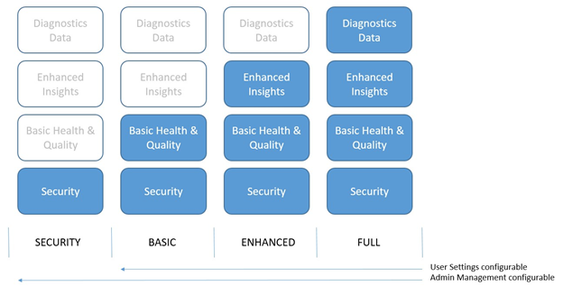
Windows Telemetry
Notes:
Basic and Enhanced is available for <Win 10 Telemetry
https://docs.microsoft.com/en-us/previous-versions/windows/it-pro/windows-8.1-and-8/appraiser-diagnostic-data-events-and-fields

Slide 35
Per Solution Requirements
Solution | OS Versions | Min Telemetry Level | Required Windows License
Upgrade Readiness | Win7 SP1, Win10 | Win 7 – opt-in Win 10 - Basic for most things Enhanced for Win10 App Usage, Office addins and IE site discovery insights | No additional requirements
Update Compliance | Win10 | Basic | No additional requirements
Device health | Win10 | Enhanced 1709 policy can “limit enhanced to just Windows Analytics events” | E3, E5 Not required/enforced per seat
All Windows Analytics are “zero rated” within Azure log analytics; not charged, don’t count against data limits
Windows 8.1 is no longer supported on Windows Analytics due to GDPR restrictions
Notes:
Windows Analytics is all about deploying, servicing and supporting windows 10. Upgrade readiness is the only solution that runs on earlier versions of Windows because it is necessary to assess these older versions when planning to upgrade to Windows 10.
Basic telemetry is all you need for Upgrade Readiness and Update Compliance. Turning on enhanced lights up Device Health and additional features in Upgrade Readiness. In 1709 we added a new policy to limit enhanced telemetry to just what is needed by Windows Analytics; these limited events are fully documented
Upgrade Readiness and Update Compliance require no additional licenses. They will just work on all business versions of Windows.
For device health, you need enough E3 licenses to cover your usage; so if you want to monitor 100 devices you need 100 licenses. We don’t require licenses per-seat (e.g., it’s OK if some of the devices being monitored are on pro)
Note on Analytics “zero rating”;
If using Azure Log Analytics “free tier”, analytics data doesn’t count against the 500MB/day ingestion limit
If using one of Azure Log Analytics premium tiers (which chart $2.50 or $3.50 per GB for ingested data), analytics data is excluded from billing

Slide 36
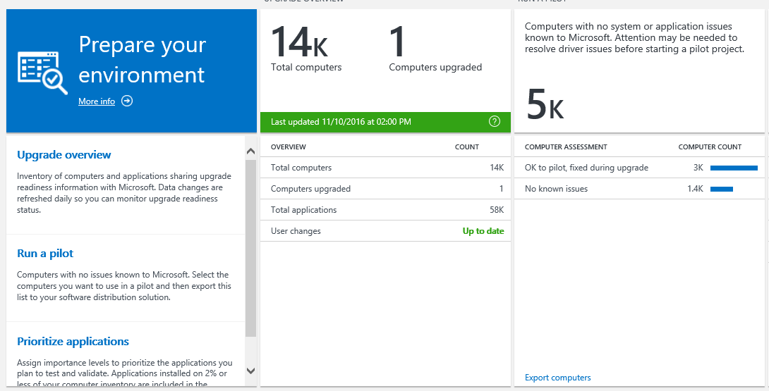
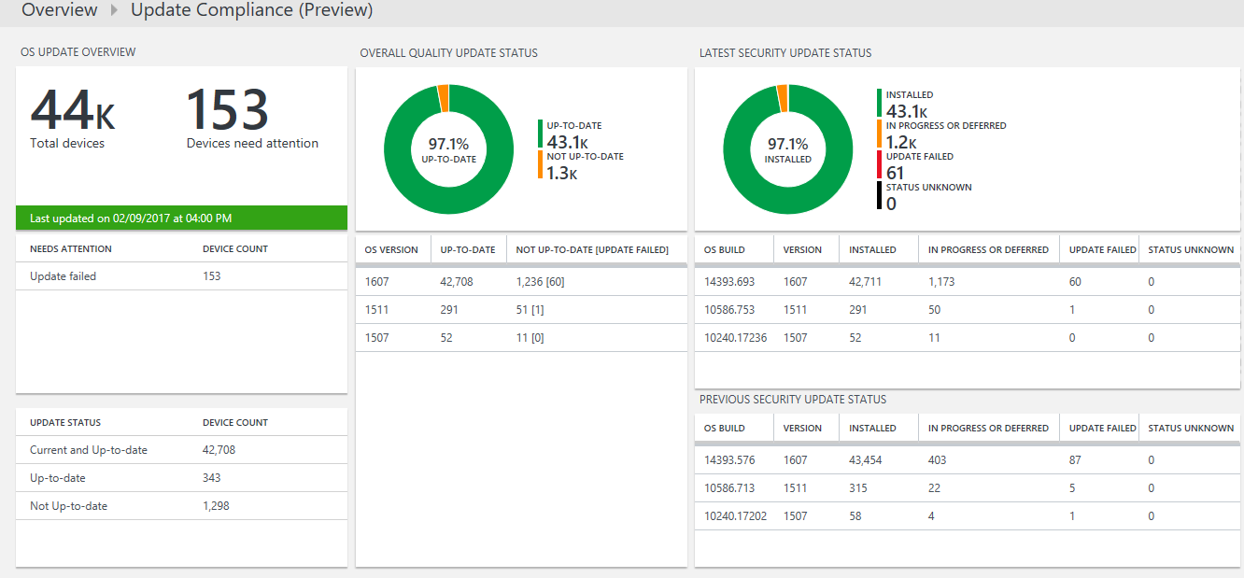
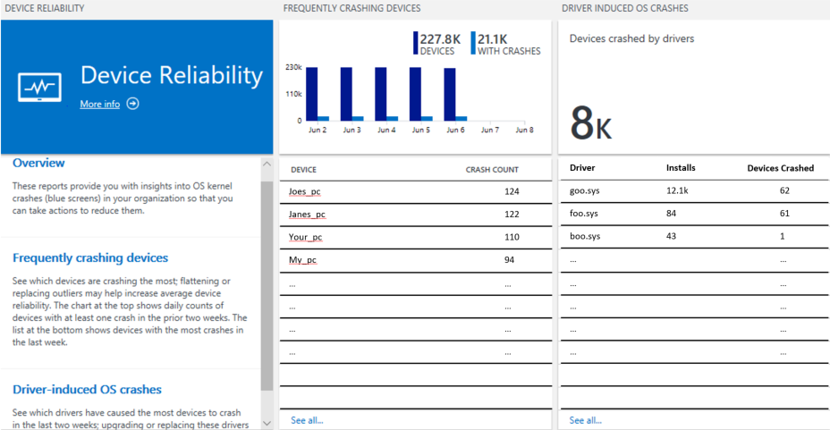
Windows Analytics
Data-driven insights to reduce the cost of deploying, servicing, and supporting Windows 10
Upgrade Readiness
Update Compliance
Device Health
Plan upgrades by identifying devices that are ready, identify and resolve app and driver compatibility blockers
Ensure update and antimalware compliance with timely reports for all your devices (even those on the road)
Reduce support costs by pro-actively identifying and remediating top end-user impacting issues
No agents to deploy
Works with your existing infra; AAD or AD, SCCM or Intune, win32 or store apps, …
No additional cost beyond existing Windows licenses
Notes:
Windows Analytics is comprised of three solutions:
Upgrade Readiness (which used to be called Windows Upgrade Analytics), which helps organizations plan for Windows 10 upgrades by helping identify and resolve app and driver compatibility blockers. This was built by the app-compat team, who are experts in this type of analysis and are sharing their “secret sauce” with you.
Windows Analytics Update Compliance, designed to help you stay up-to-date on Windows 10 by ensuring all your devices are on a supported version of windows 10 and are up-to-date on their patches and defender signatures. This was build by the servicing team, who are experts in servicing windows to keep it up-to-date.
Windows Analytics Device Health, designed to reduce support costs by pro-actively identifying and remediating top end-user impacting issues. Because an IT pros worst fear isn’t failing to keep machines up-to-date, it’s causing wide-spread problems by updating them.
Together, these three solutions help you get current (UR), stay current (UC) and stay healthy (DH) with Windows 10.

Slide 37

Data Flow Overview
US
US
Various Regions
3. Analytics-specific processing produces daily “snapshot”
Transient storage
5. Per-workspace data copied
+ user input
Azure (Log Analytics storage)
4. Daily snapshot copied
Diagnostic Data Management Service
Analytics Azure Storage
6. User input
2a. Create Log Analytics workspace in Azure, gets Commercial ID
1. Diagnostic Data Upload
2b. Enroll devices in their Analytics Workspace by setting Commercial ID, enables diagnostic data
Windows Desktop
IT Admin

Slide 38
Diagnostic Data Viewer
DDV
Windows Feedback Hub – Things that are broken
Wire Shark - Comms
Postman - APIs

Slide 39

Telemetry – Huh What is it good for?
Absolutely EVERYTHING!
To the Cloud
Telemetry
Can I see it?
Can I Gather my own?
The Tale of the Slow Registry
Windows Performance Recorder
Windows Performance Analyzer

Slide 40
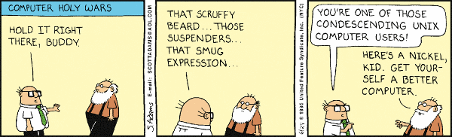
Performance Gathering – The old way
xperf:
Trace capture, processing, and command-line analysis
xperfview:
Visual trace analysis
Xbootmgr (and xbootmgrSleep):
On/Off transition trace capture
hwpower2etw:
TDMS-to-ETL converter
symcachegen:
PDB-to-SymCache generator

Slide 41
The Big Picture
XML file
XPerfView
6. CLI trace analysis via actions
5. GUI trace analysis via graphs and summary tables
3. Controls logging sessions and enables/disables providers
Merged ETL file
Action
XPerf
System and Symbol Information
Control/Status
Control/Status
Post Processing
Control/Status
4. Metadata injection
ETW
ETL file
Event Providers
ETW Session
Event Providers
1. Collection of configurable in-memory buffers that is managed by the kernel
2. Any component that has been instrumented with Event Tracing API
Control/Status
Data flow
Notes:
https://www.microsoft.com/en-us/p/windows-performance-analyzer/9n0w1b2bxgnz?activetab=pivot:overviewtab#

Slide 42
What is WPT and where do I get it?
Windows Performance Recorder (WPR)
Allows you to capture a trace for the problem you want to investigate
Get it from the ADK – aka.ms/adk
Windows Performance Analyzer (WPA)
Exposes information about the system and allows you to do performance analysis
Git it Microsoft STORE!

Slide 43
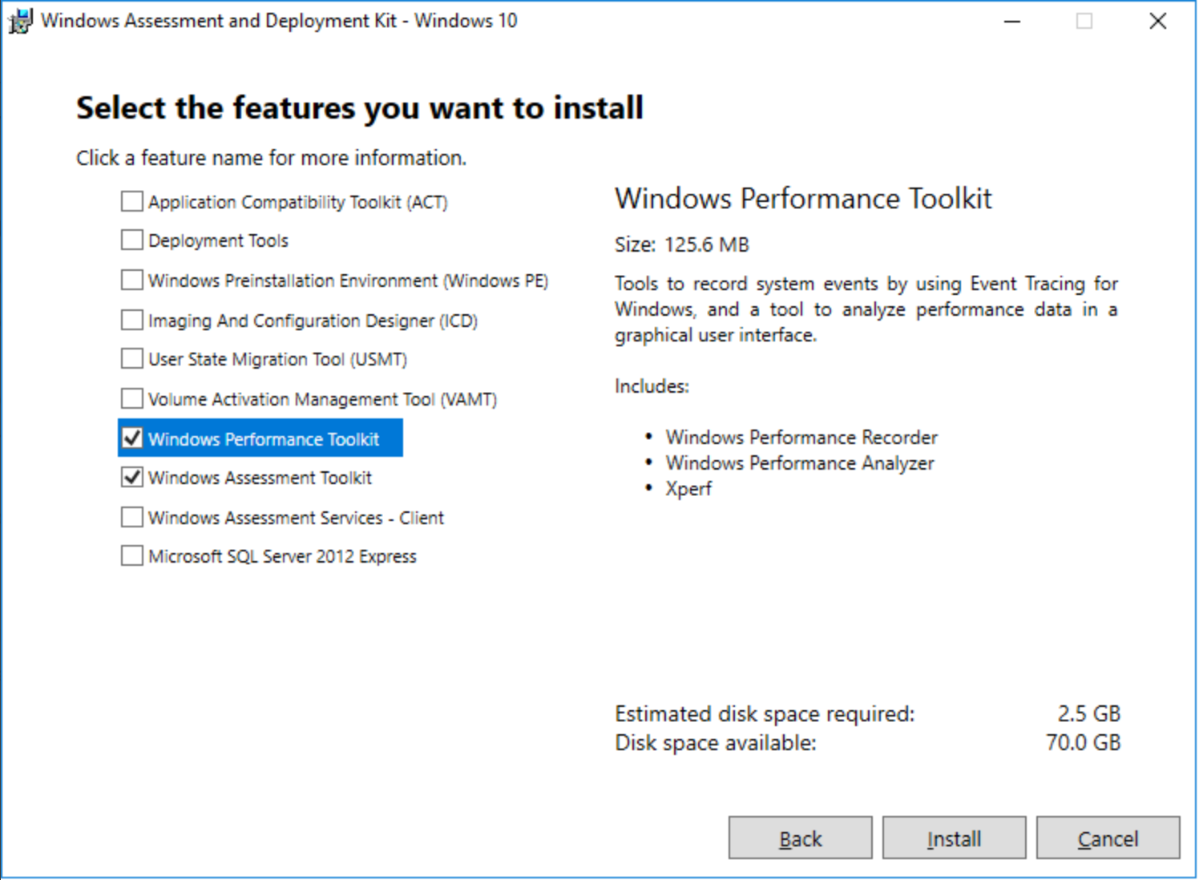
Windows Performance Analyzer
Notes:
https://www.microsoft.com/en-us/p/windows-performance-analyzer/9n0w1b2bxgnz?activetab=pivot:overviewtab

Slide 44
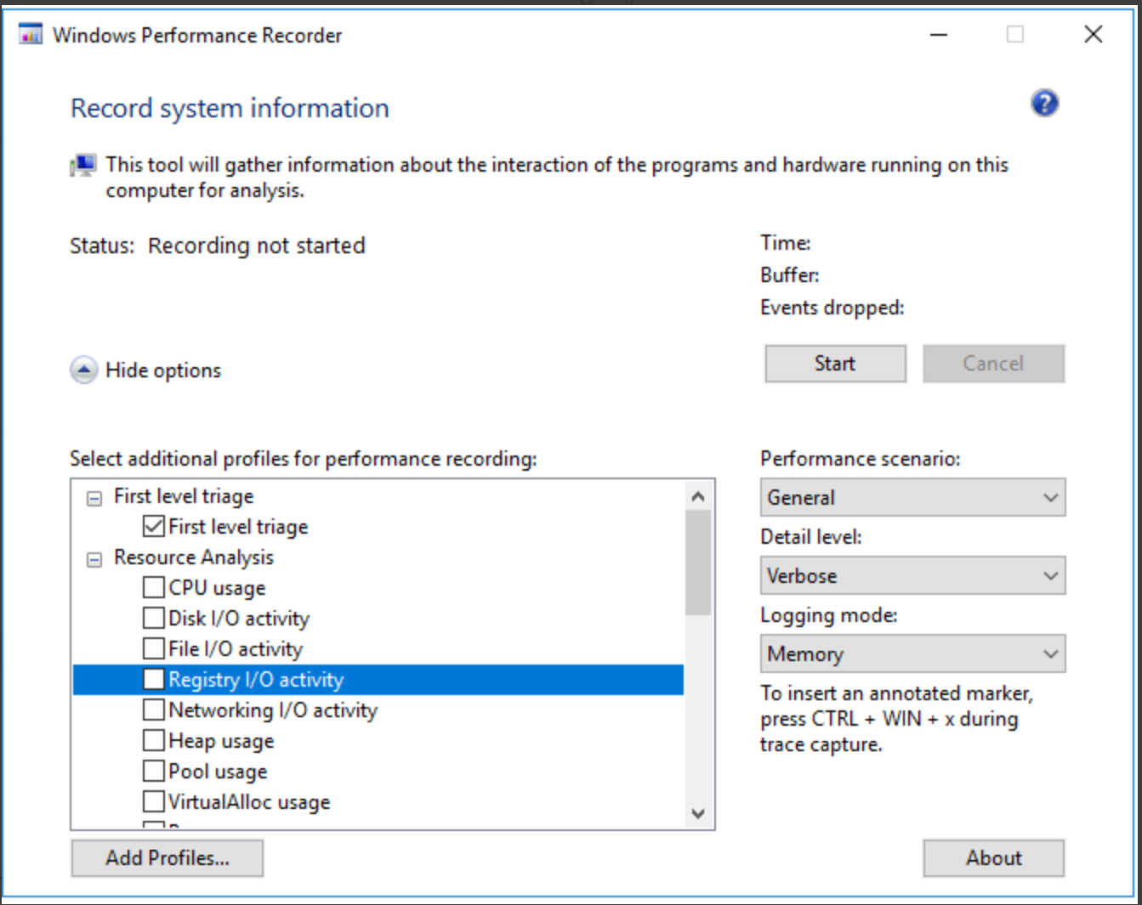
How do I capture a trace?
metrics emptyapp64 RegWriteHKLM -t
Start Windows Performance Recorder
Prior to 1903 index service won’t find it ☹
Once you start SHOW HIDE OPTIONS
Replication!
Windows Metrics Tool kit
metrics emptyapp64 RegWriteHKLM -t

Slide 45
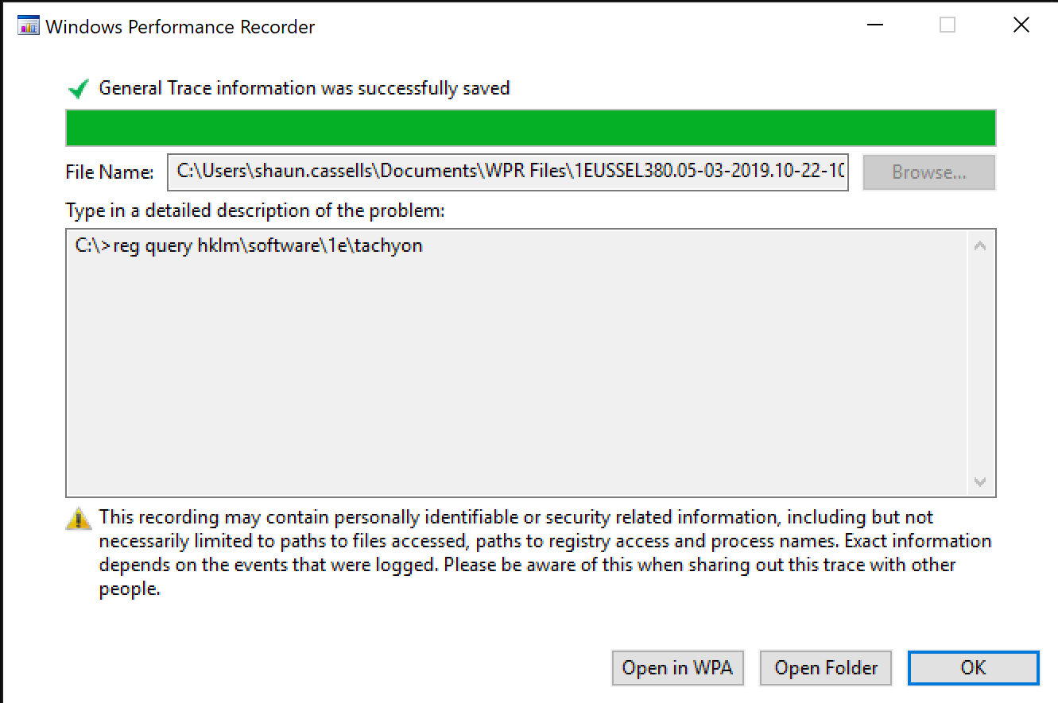
Saving
Get a cuppa this is going to take a minute
Saves to local Document\WPR Files\ -> If your documents are redirected expect to take longer
Yea for Open in WPA

Slide 46
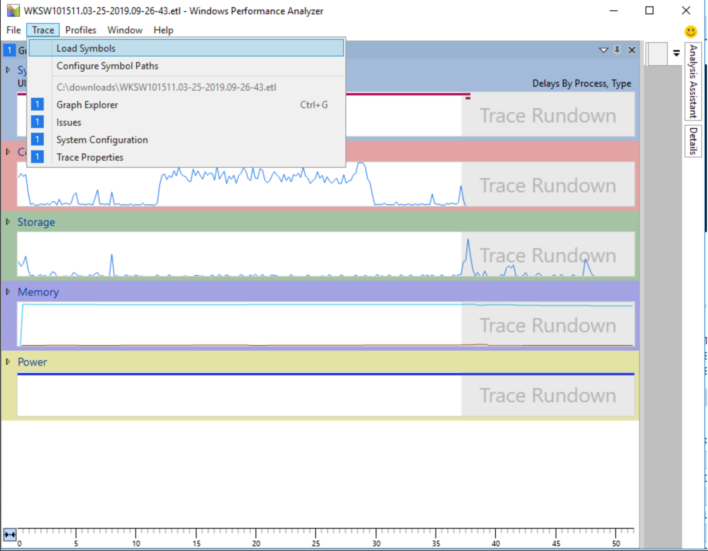
overview of WPA
Load Symbols may take a while

Slide 47
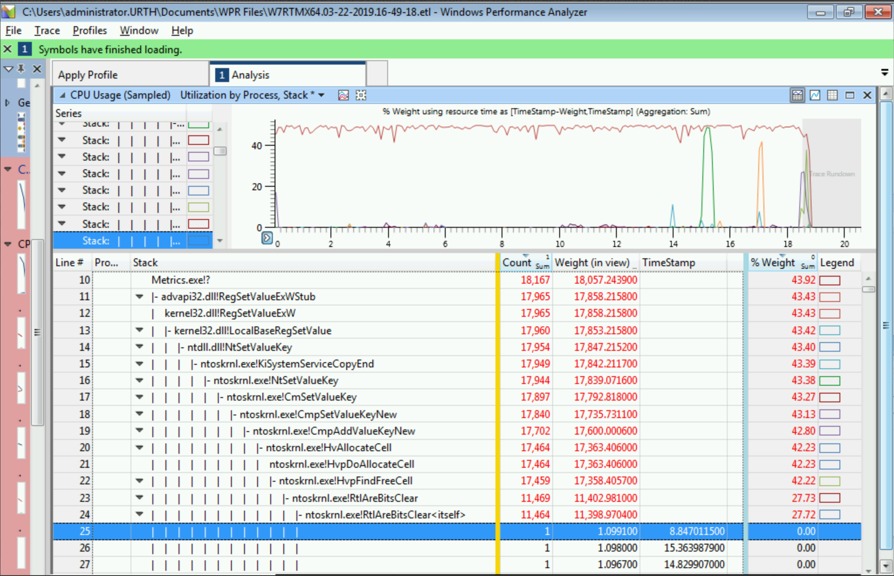

Slide 48
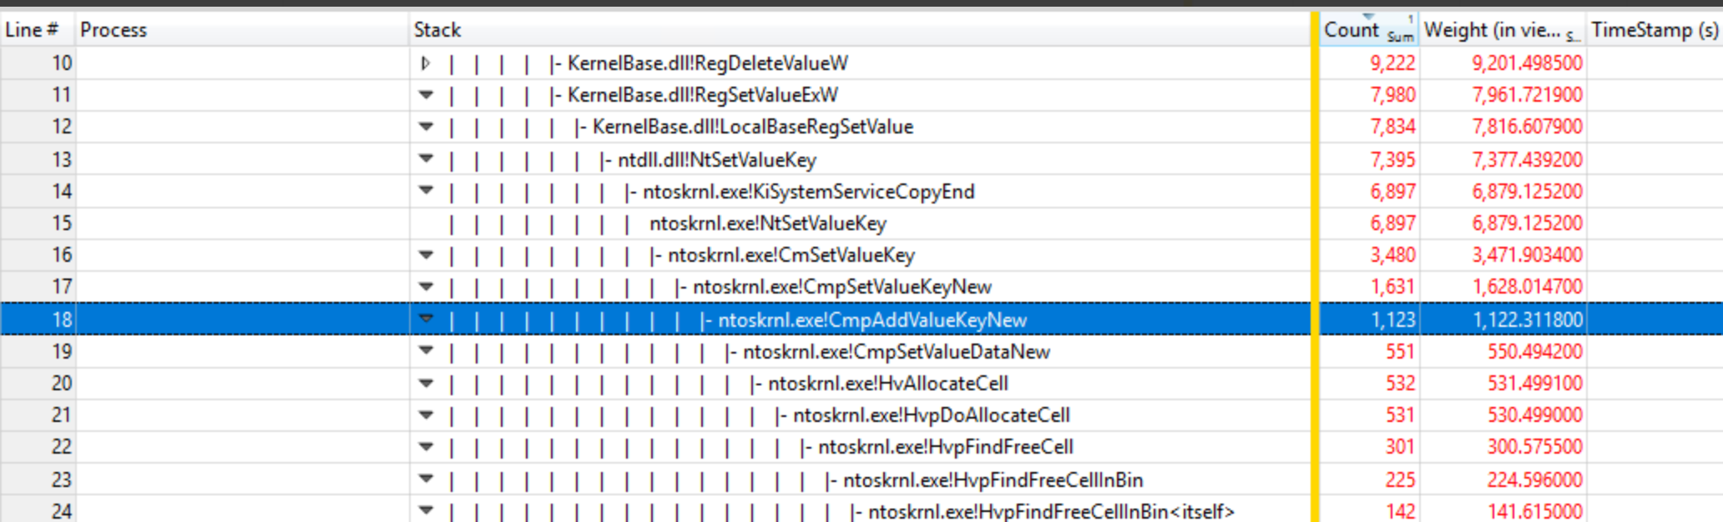

Slide 49
Summary

Slide 50
DTrace
There has to be a better way
ETW is so static
DTRACE!!!
Open Source as of 2016
Used in all Insider Builds
https://techcommunity.microsoft.com/t5/Windows-Kernel-Internals/DTrace-on-Windows/ba-p/362902
Download https://www.microsoft.com/en-us/download/details.aspx?id=58091

Slide 51
DPAPI

Slide 52
Data Protection API
A set of Win32 APIs that allow you to encrypt data with great easy.
The user’s password hash encrypts:
Old user password hash
Current key – refreshed every 90 days
Used in:
IE saved passwords
Picture, fingerprint ect authentication
ConvertFrom-SecureString
Credential manager

Slide 53
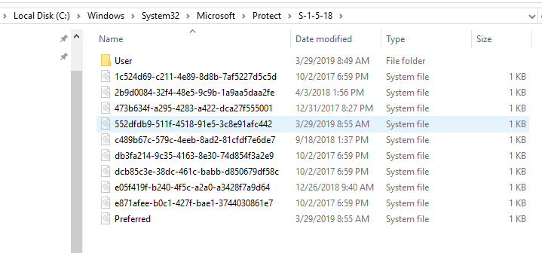
DPAPI Encryption - Subsystem
Local system
%WINDIR%/System32/Microsoft/Protect
Current User – Semi Portable
%appdata%\Microsoft\Protect

Slide 54
DPAPI Encryption – credential manager
Is the Credential Manager a good place for Passwords:
It depends
The API for Credential manager is standard and easy to use and an obvious spot for hackers
Most implementation skip adding entropy
https://github.com/davotronic5000/PowerShell_Credential_Manager

Slide 55
Other Crazy Topics
What part of windows surprised you when you learned how it worked?
Any suggestions for future topics?

Slide 56
Stephen Owen @FoxDeploy
Shaun Cassels @Cassles
Jeff Scripter @JeffTheScripter

Slide 57
Resources / Links
Comprehensive guide to WMI – LogicMonitor http://bit.ly/wmiguide
There’s something about WMI – SANS DFIR http://bit.ly/wmi4evil
PowerShell History – Snover http://bit.ly/poshhistory

Slide 58
Telemetry Resources
Diagnostic Data Viewer - https://bit.ly/2Y6CV13
Windows Insider Flight Hub - https://docs.microsoft.com/en-us/windows-insider/flight-hub/
Windows ADK - https://aka.ms/adk
Windows Performance Toolkit - https://docs.microsoft.com/en-us/windows-hardware/test/wpt/
Windows Performance Analyzer - https://bit.ly/2vANA7Q
DTrace - https://www.microsoft.com/en-us/download/details.aspx?id=58091

Slide 59


Slide 61
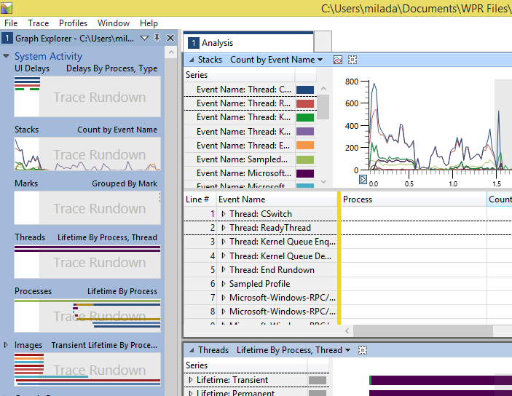
Let’s get started…
Graph Explorer
Left pane that contains all the views into the data in your trace
Analysis Tabs
Drag graphs into different tabs to customize your view
Graph and table
Each view has a visualization and a table that aggregates the data in the view
Can be in graph only, table only, or graph and table mode

Slide 62
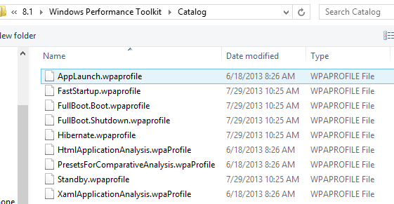
Field Tricks #01: WPA - Profiles
Predefined view of graphs and tables arranged in analysis tabs.
Catalog contains different profiles to jumpstart your analysis
Go to Profile > Apply > Browse Catalog

Slide 63
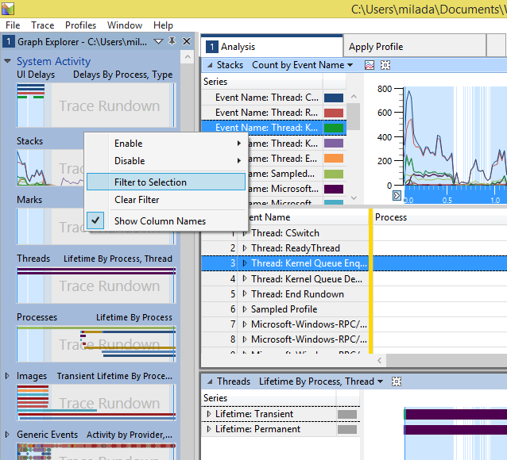
Field Tricks #02: WPA – Common cmdlts.
Zoom
Trim the timeline you’re looking at
Click and drag to select, right click and zoom (or press CTRL + .)
Filter to selection
Trim data you’re looking at in a given table
Select an item (in table or legend), right click and filter

Slide 64
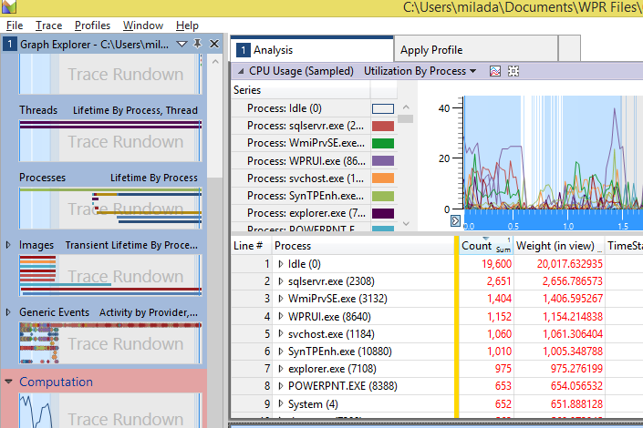
CPU Usage (Sampled)
Description
Graph provides a 3rd view of CPU usage in your system based on CPU samples.
Key Information
Summary table is especially useful for understanding what code is running at any given time.
Zoom into a region that you are interested in and expand the Stack column for your app.

Slide 65
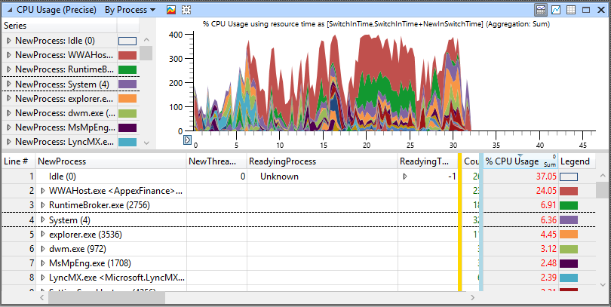
CPU Usage (Precise)
Description
Summary table shows overall CPU Usage, based on context switch events.
Key Information
You can use this summary table to understand, at a high level, what processes are running on your system.
You can also expand each Process to see its component threads.

Slide 66
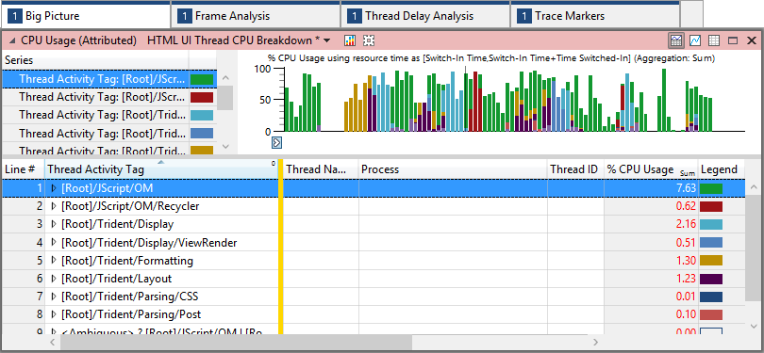
CPU Usage (Attributed)
Description
Summary table breaks down the CPU costs into several categories that are important for analysis.
Key Information
Thread Activity Tag column aggregates costs into several defined categories.
Several preset views available that allow you to filter the data to specific types of threads.
Typically use the UI Thread preset views for our analysis.

Slide 67
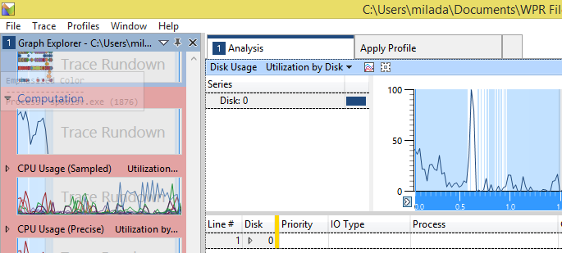
Disk Usage
Description
Graph shows disk activity on your system.
Key Information
Typically use this in its graph view, to correlate disk activity with delays in our app.
There are numerous preset views that help you to dig in to the different types of disk I/O and utilization in your system.

Slide 68
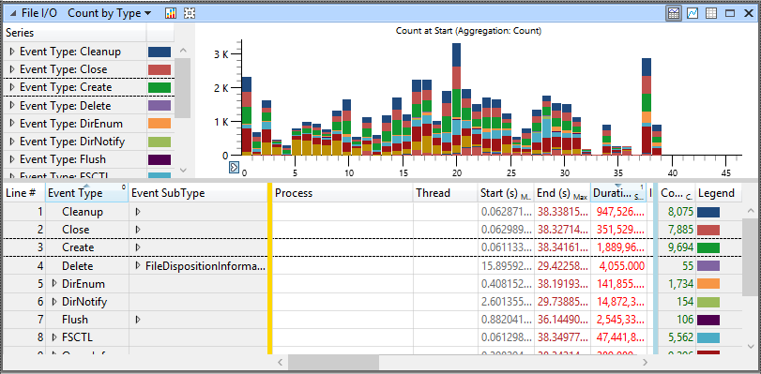
File I/O
Description
Graph shows disk activity on your system with a per-file granularity.
Key Information
To populate this graph with data, you must enable the “File I/O activity” profile when you collect your trace.
Graph allows you to see exactly which files were requested by your app (See the File Name column) and what type of File operation it used.

Slide 69
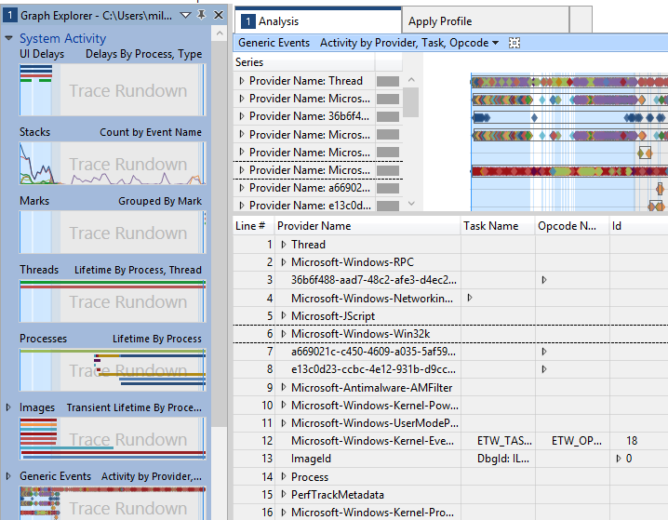
Generic Events
Description
Summary table presents all events that were collected in your trace.
Key Information
We have provided several filters to make these events more useful:
Touch Events – shows marks for each type of touch event
msWriteProfilerMark – shows markers for each of the events that msWriteProfilerMark logs
VSync-DWMFrame – marks the VSync events during screen updates with red lines

Slide 70
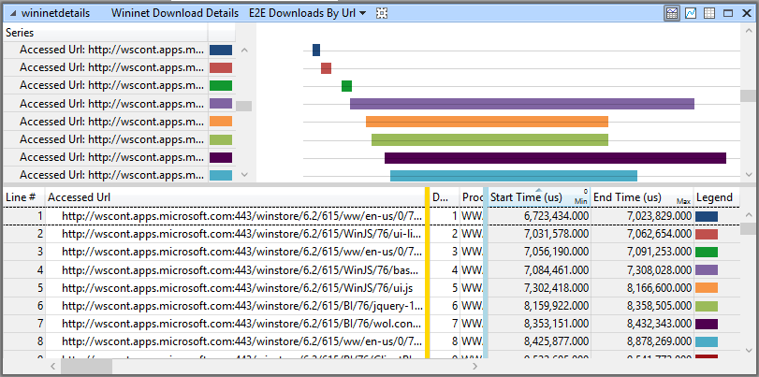
WinInet
Description
Summary table and graph show what network requests were made on your system.
Key Information
This graph helps to identify what network requests your app makes or is blocked by.
If your app’s UI thread CPU usage dips, only to return after a network request completes, it was probably blocked by the network request.

Slide 71
Section Header
This is the next section

Slide 72
Title
Line1
Bullet Level 1
Bullet Level 2
Bullet Level 3

Slide 73
Title
Code

Slide 74
Text Only with Border
Level 1
Level 2
Level 3

Slide 75
Text Only (Red)
Level 1
Level 2
Level 3

Slide 76
Title
Text 1
Level 1
Level 2
Level 3
Text 2
Level 1
Level 2
Level 3

Slide 77
Title
Section 1
Section 2
Text
Level 1
Level 2
Level 3
Text
Level 1
Level 2
Level 3

Slide 78
Demo Title

